Slide 1

Group 14
Level 4/5 Group 14: Ethan Ward, Mircea Lazar, Petrut Vasile, Toby White

Slide 2
How the game fits the brief
E
The game is 2d
The only control is tapping
Each player has a turn within one round
The game will be played on one device
The level design is symmetric
There are two mechanics which make the game simple and intuitive
Notes:
Ethan

Slide 3

Target audience
P
Core audience
Ages between 11-25
Male
casual gamers
Notes:
Petrut

Slide 4

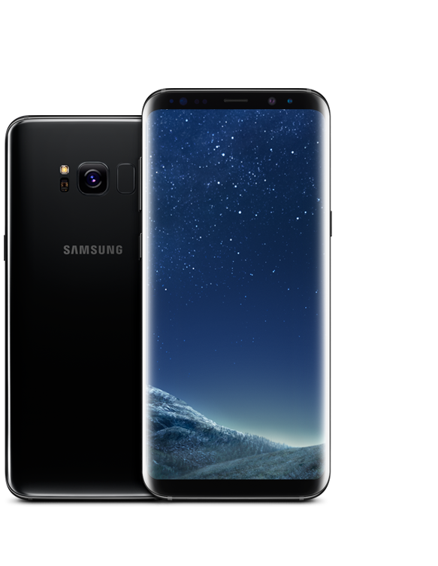


Markets and platform
M
Platform
Mobile phones
Supported platforms: Android and IOS
Markets
Smartphone markets
Google play store
IOS App store
Amazon app store
Notes:
Mircea

Slide 5
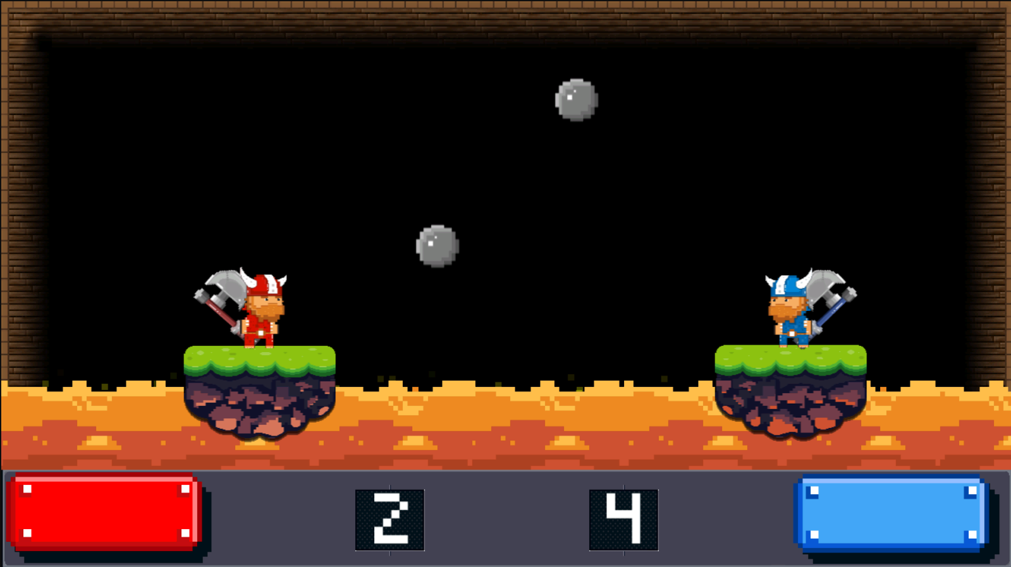
Games we looked at: Mini Battles
P
Viking mini game
In this mini game two players are spawned on a moving platform and the throw axes at each other trying to avoid hitting the obstacles that are between them. When the axe is on cooldown you can tap to jump instead so you can dodge the opponent’s axe.
Notes:
https://play.google.com/store/apps/details?id=com.shareddreams.twelveminibattles&hl=en
Petrut

Slide 6
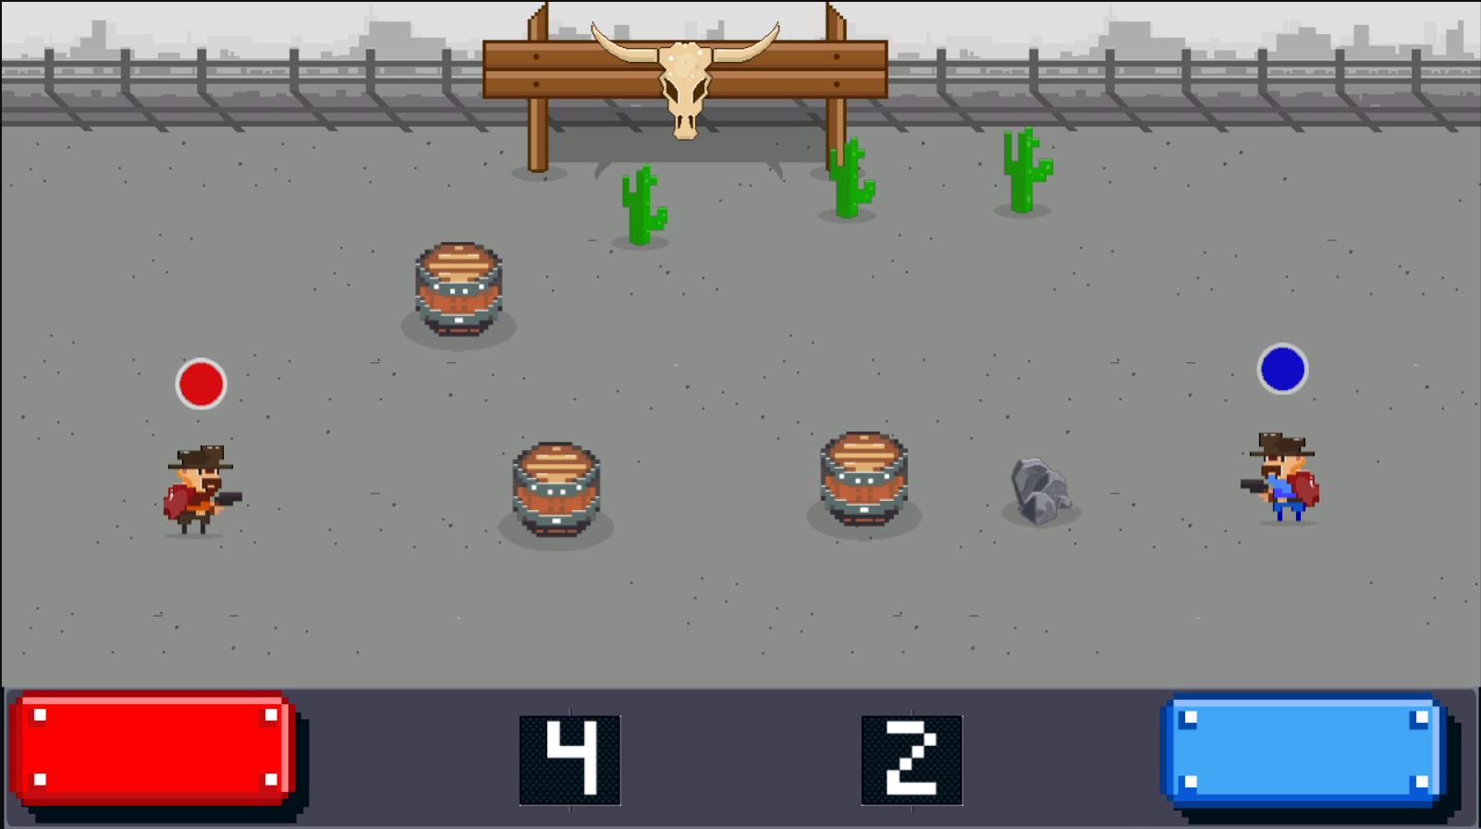
Games we looked at: Mini Battles
P
Cowboy mini game
Another interesting mini-game is Cowboy. The two players are moving up and down and are shooting at each other every couple of seconds. Between the players are obstacles/powerups that can:
Bounce the bullet back.
Make the bullet speed lower.
Spawn additional bullets.
Notes:
https://play.google.com/store/apps/details?id=com.shareddreams.twelveminibattles&hl=en
Petrut

Slide 7
What are the games challenges?
T
Getting the projectile to hit the player which is on the other side of the screen
Timing the shot as the launcher is moving until you tap
Knowing how much power to have to hit the target
Being able to hit the other player when there wind involved
Notes:
Toby

Slide 8
What is the core game loop?
M
1.
Wait for the shot to be at the right angle, tap to set.
5.
When both shots are locked in, projectiles fire at the same time.
2.
Wait for the shot power to be in the right position, tap to set.
4.
Player two repeats player one process
3.
Shot gets locked in, player one turn finished.
Notes:
Mircea

Slide 9
What does the player do?
E
Players will take turns in firing projectiles at each other.
The angle of the launcher will be changing until the player taps, at this point it will lock into place.
The shot power will be changing until the player taps.
When both players have selected their shot angle and power the projectiles will fire.
The end goal will be for one player to get the other persons health to zero.
Notes:
EThan

Slide 10
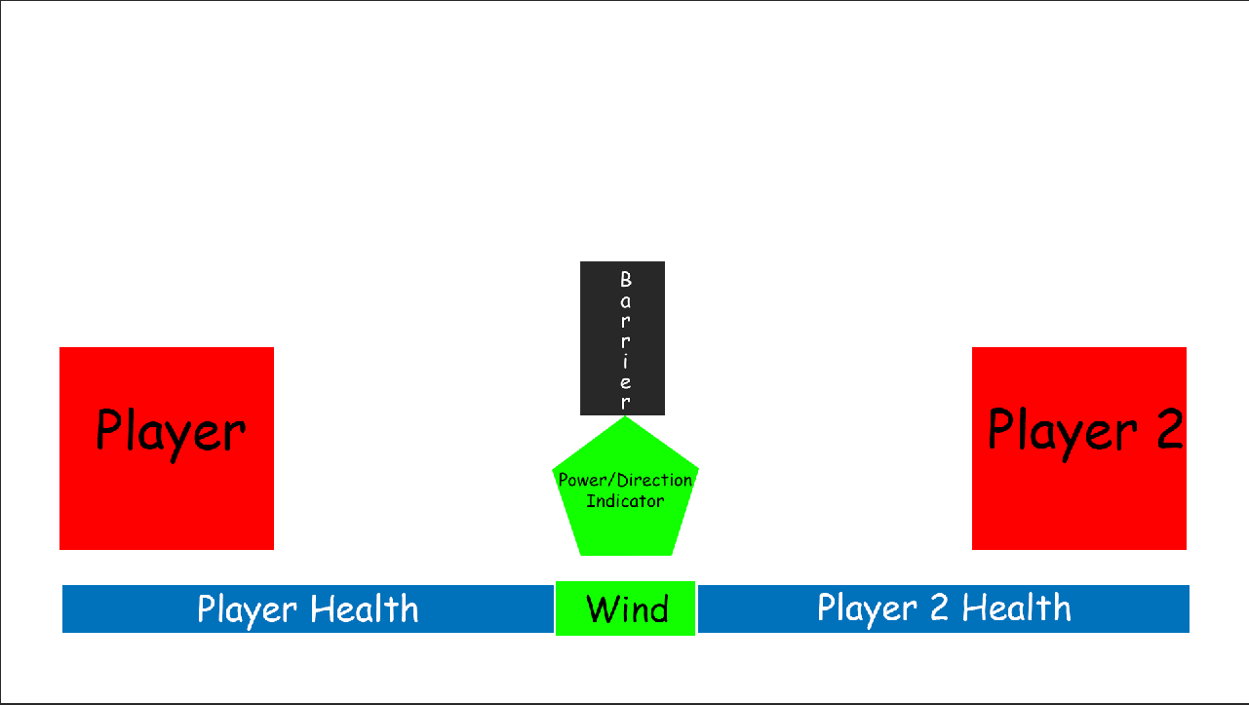
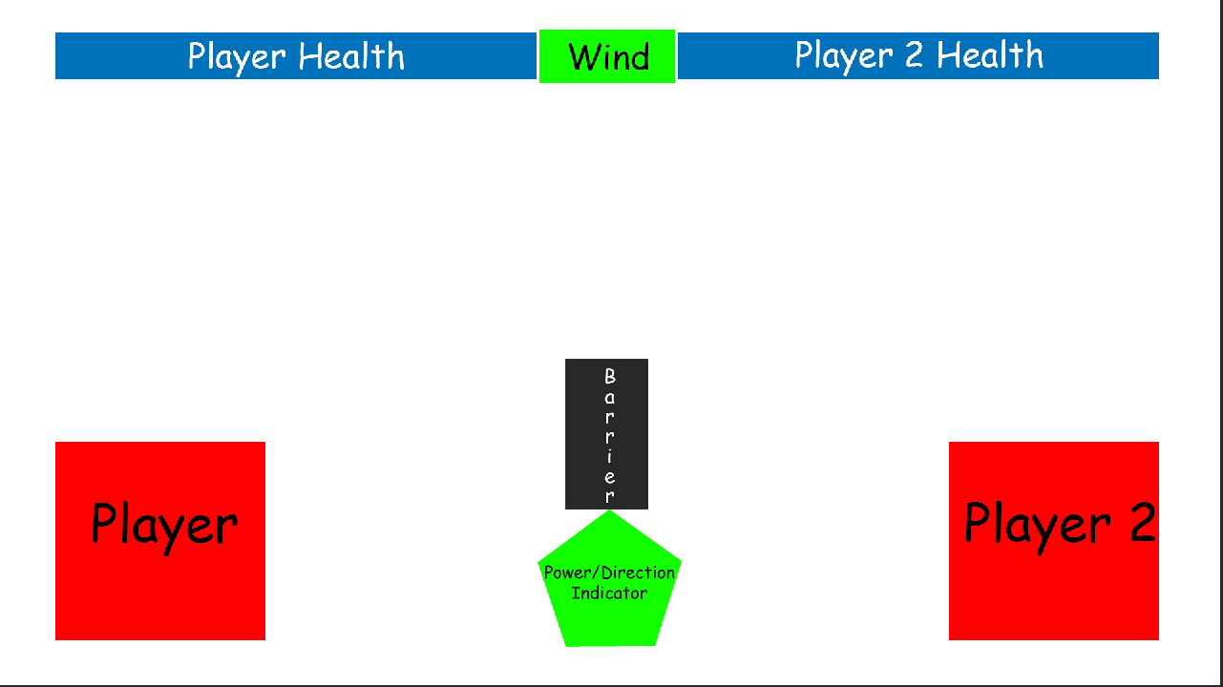
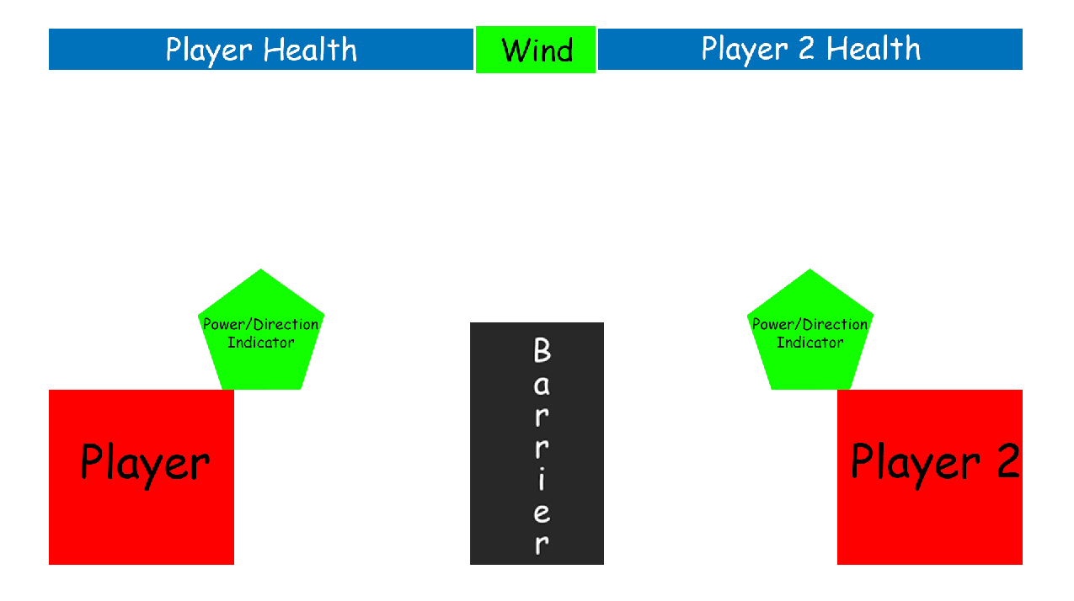
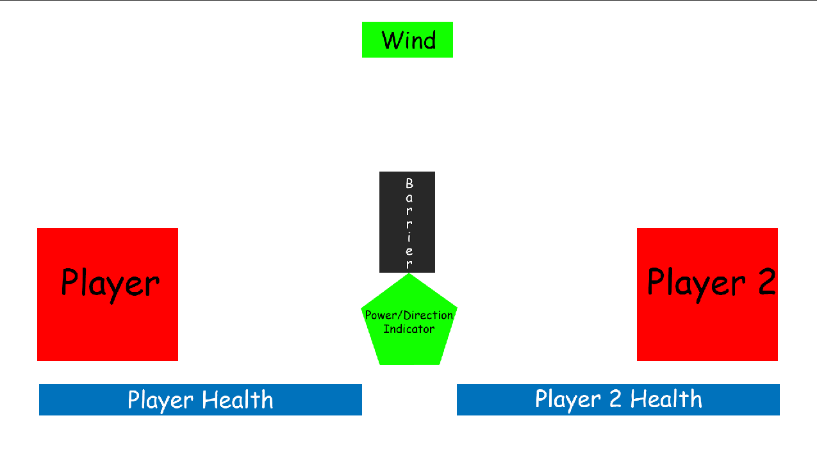
Screen mock-up
T

Slide 11
First mechanic: Firing projectile
M
The player will tap to set the position of the launcher
The player will tap again to set the power of the shot
The shot will lock in and then the other player will have their go
When both players have aimed and set the power, both shots will go at the same time.
Notes:
Ethan

Slide 12
Second mechanic: Wind
E
There will be a force (wind) that effects the projectile when it is launched.
This will be the same force for each player
Notes:
On some turns there will be wind that can affect the projectile. to make sure that this is fair for each player, the same force will be applied for both shots.
Ethan

Slide 13
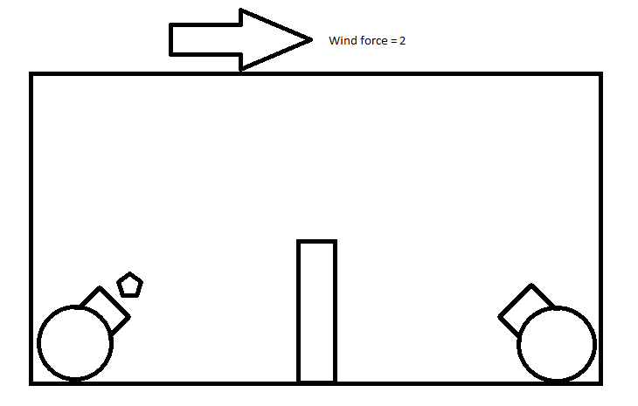
To keep things Symmetrical
Player 1
Player 2
Notes:
The same force will be applied to each of the players turns to keep things symmetrical

Slide 14
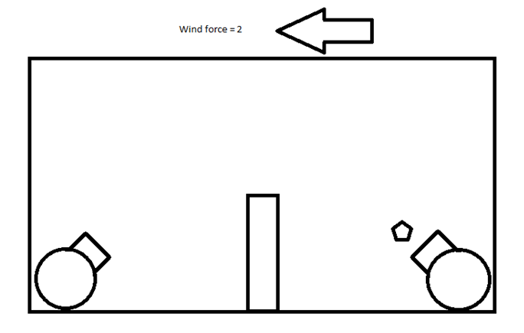
To keep things Symmetrical
Player 1
Player 2
Notes:
The same force will be applied to each of the players turns to keep things symmetrical

Slide 15
The player experience
T
We want both of the players to experience a sense of hard fun
Fiero, strategy and obstacles
A sense of people fun
Amusement and player interaction
Notes:
Toby

Slide 16
The following week
E
Picking a theme
Art assets for the theme
Building a prototype to get first mechanic working
Notes:
Ethan

Slide 17
Any Questions?

